Slide 1
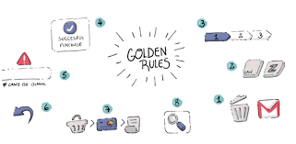
Shneiderman’s Eight Golden Rules
By
Dhivya.K
M.Tech CSE
30/08/2022

Slide 2
INTRODUCTION
This presentation is exhibiting the Hotstar application which is what I took it as the example whether it poses a Shneiderman’s Eight Golden Rules
Hotstar is introduced in the year Jan 7, 2015
Now a day Hotstar application is used by 15 million mobile users and 20.3Lakhs laptop users are there
Hotstar is #1 Top free in entertainment application
Mobile version 12.4.5 updated on Aug 23, 2022
Required android version 5.0 and up
Offered by NOVI DIGITAL

Slide 3
Shneiderman’s Eight Golden Rules
Strive for consistency
Enable frequent users to use shortcuts
Offer informative feedback
Design dialogue to yield closure
Offer simple error handling
Permit easy reversal of actions
Support internal locus of control
Reduce short-term memory load

Slide 4
Strive for consistency
ICONS:
Watchlist icon
Download icon
Latest & Trending
Best in Sports
New movies for you
Because you watched Taanakkaran
Superhero
Top 10 in India Today – TAMIL
Comedy Movies
Disney movies
Asia cup
Best of Foreign shows Dubbed
Popular Movies
Popular Shows
Romance Movies
Kids Movies
Star Vijay Shows
Horror
Drama
Thriller Shows
Marvel Movies
Star Maa shows
Quix Shows
Live Streaming
Popular in Comedy

Slide 5
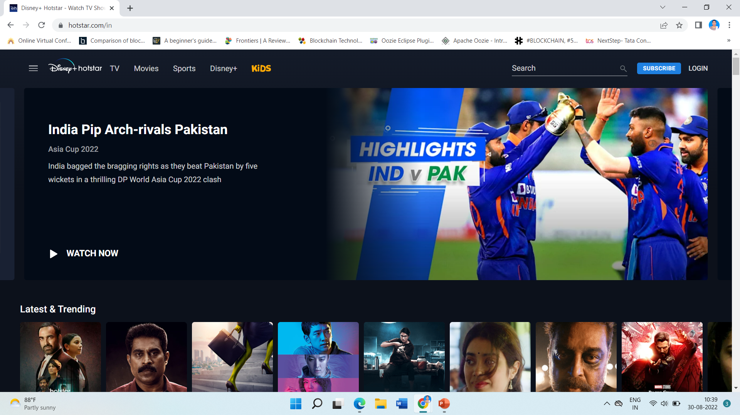

Slide 6
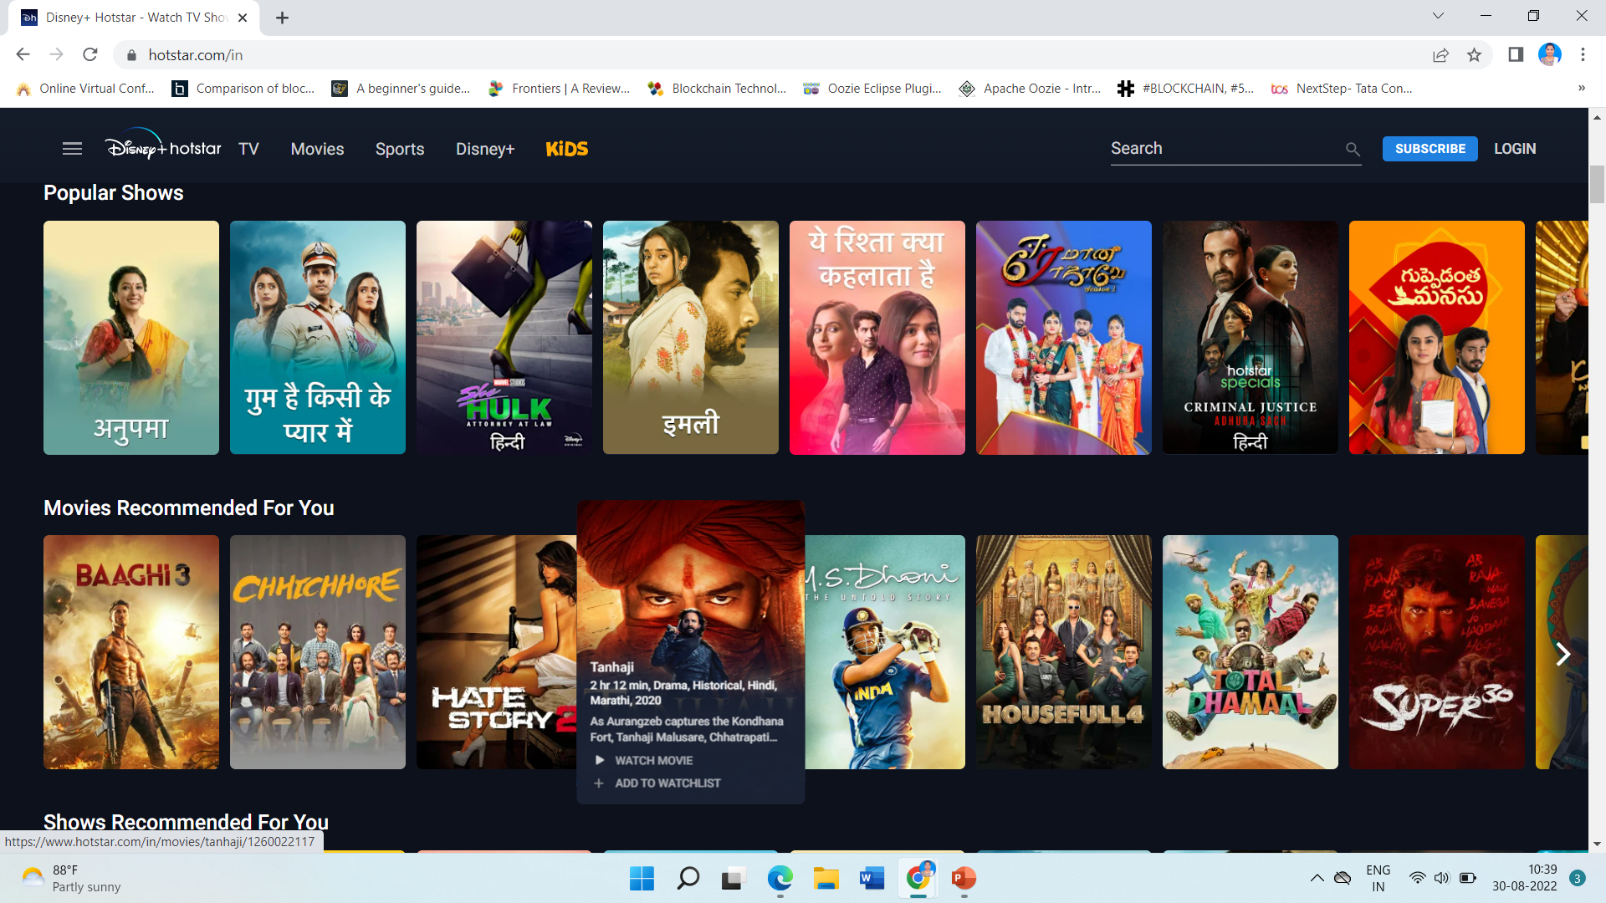

Slide 7

Strive for consistency(Cont,..)
Popular in Drama
Popular in Love
Popular in Crime
Popular in Biopic
Popular in Travel
Popular in Documentary
Popular in Teen
Popular in Science
Popular in Talkshow
Hotstar Special
Popular Languages
Tamil, English, Odia, Hindi, Telugu, Bengali, Malayalam, Marathi etc
Upgrade
Popular Channels
COLOR: (Dark Blue)
Knowledge
Power
Integrity
Seriousness
MENU HIERARCHY:
Latest & Trending → Heaven → Watch.
Upgrade → (Mobile, Super, Premium) → upgrade now → Pay Securely ( Credit cards, Debit Cards, Wallets, UPI) → Enter details → Continue → Make Payment → Transaction Processing → Loading → Payment Done → Upgraded

Slide 8
Strive for consistency(Cont,..)
CALL FOR ACTION:
Dedicate ourself completely to watch new movies, sports, serails, etc
USER FLOW:
It Maintain Same Flow
The Instances where HOTSTAR does NOT handle the rule well:
a. Adding stories
b. Adding Posts
c. Go Live feature
d. The direct message

Slide 9
Enable frequent users to use shortcuts
Disney Plus Hotstar keyboard shortcuts
M – Mute sound
F – Fullscreen mode
Esc – Exit Fullscreen mode
Spacebar – Play or pause video
Right arrow – Go forward 10 seconds in a video
Left arrow – Go back 10 seconds in a video
Tab – Move through top menu options or movie and TV choices
Enter – Used when highlighted movie, TV show, or menu item is ready
The Instances where HOTSTAR does NOT handle the rule well:
The HOTSTAR Application on the desktop as well as mobile does not have any voice feature activated which would allow people universal usability.

Slide 10
Offer informative feedback
New Episodes
Top 10 Movies/Popular
Home Page has Popular RUN
While deleting downloaded videos it shows message correctly
The Instances where HOTSTAR does NOT handle the rule well:
While displaying a video on HOTSTAR, the user does not have an idea of the amount of time required to load the entire video. No feedback is offered in terms of the wait time and the user have to wait until the video loads. There is no playback control or navigation bar such as the one exists on YouTube.

Slide 11
Design dialogue to yield closure
Click any Movie → Ask (Watchlist, Watch, Episodes)
Click any Movie → Ask (Watchlist, Watch, Episodes)→Download → Select Quality (HD,SD)

Slide 12
Offer simple error handling
Playback stream not available
Something went wrong. We are working on it. Please try again in a bit.
Hotstar error HP-4030: This content is not available in your region.
Hotstar error DR-1100: Error playing this content due to DRM issues. Please try again.
Hotstar error HWEB-1006: You seem to be offline. Please check your internet connection.
Hotstar error 01008: There is a problem connecting to Hotstar service. Please try again.
Hotstar error PB-1415
Hotstar error MN-1004: An error has occurred.
MEDIA_ERR_NETWORK: Uh-oh, looks like something has gone wrong. Please check your network and retry!
Hotstar error 711.
https://www.thewindowsclub.com/fix-disney-hotstar-error-codes

Slide 13
Permit easy reversal of actions
Subscription Reversal
Watchlist Reversal
Search Option Reversal

Slide 14
Support internal locus of control
Watch video by clicking on it using audio in short or home page and then mute mode also we can watch videos

Slide 15
Reduce short-term memory load
Recent Watchlist
Continue watching
Downloads
Subscription Dialogue Box
Shorten the video in wallpaper page

Slide 16
References
https://trajput.medium.com/analyzing-instagram-using-shneidermans-eight-golden-rules-of-interface-design-7ff765a845db
https://webdesign.tutsplus.com/articles/8-golden-rules-for-better-interface-design--cms-30886

Slide 17
Thank you

